Slide 1

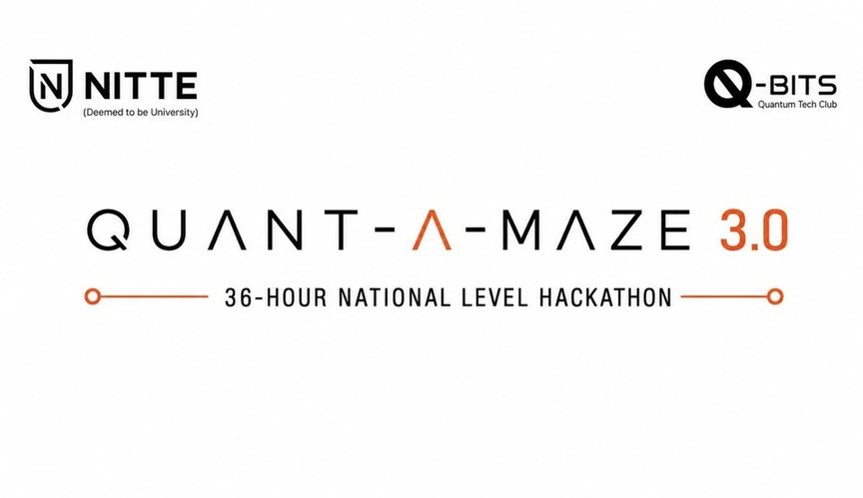


1. Participant Information & Topic Name
•
Team Name - InnovHer
•Team Lead Name -
•Team Lead Contact No -
• Selected Track :
Devadarshini P
8667848756
Quantum Machine Learning (QML)

Slide 2
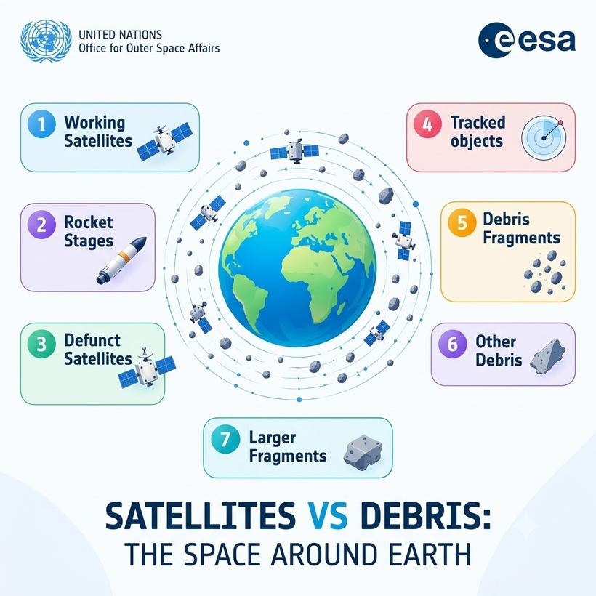
2. Problem Definition
Problem Description:
Constraint:
  Public data only (CelesTrak / Space-Track)
  No real quantum hardware — Qiskit simulator
  36-hr window limits data size & model complexity
Orbit crowded with debris at 17,000–28,000 km/h
1 Collision – 1000s of fragments(Kessler Syndrome)
Current models: slow, compute-heavy classical simulations
Real-time tracking of thousands of objects is hard
Functional Requirements
  Process TLE orbital data for satellites & debris
  A single collision creates thousands of new fragments
→ cascading chain reaction (Kessler Syndrome)
  Classify risk: Low / Medium / High
  Show predictions on a simple dashboard

Slide 3
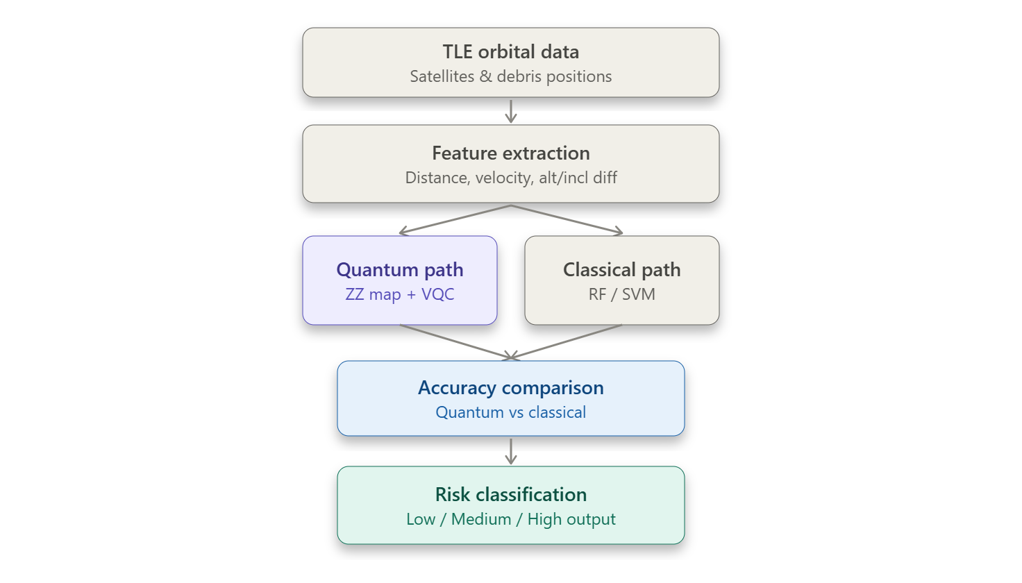
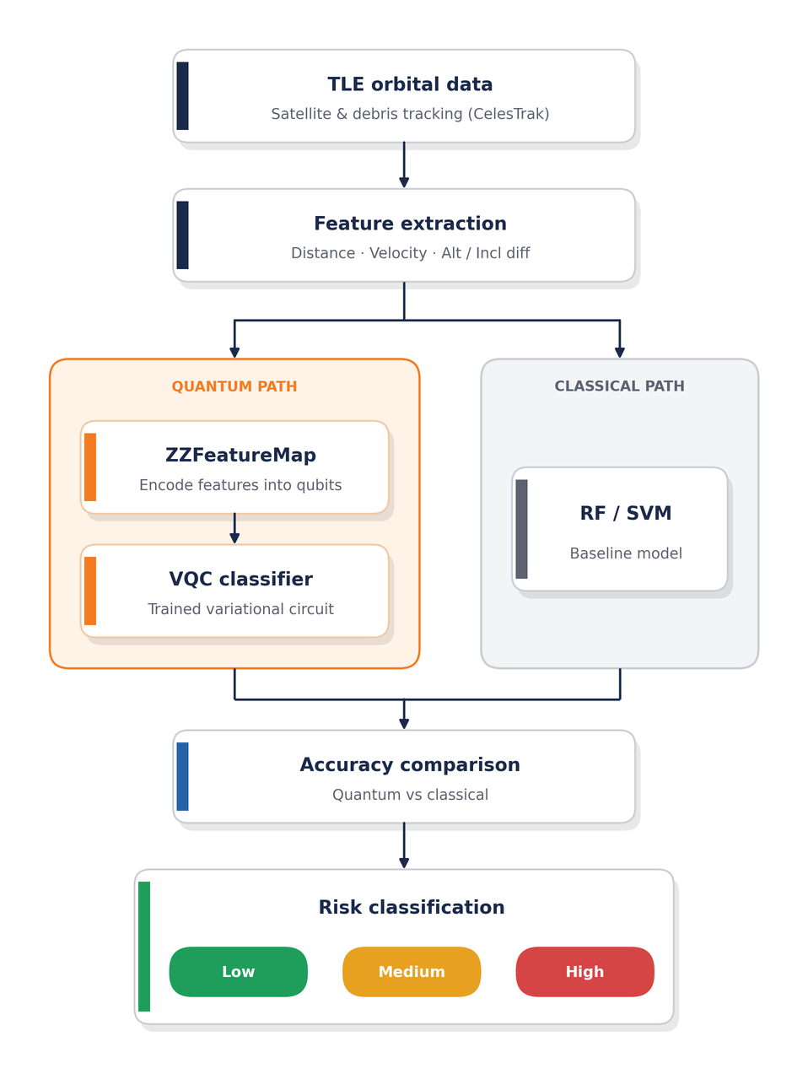
3. Proposed Solution & Execution Plan
Solution Overview
Predicts satellite–debris collision risk
It using a hybrid quantum hybrid ML Model
Early warning before a close approach happens
Working Principle / Approach:
  Extract orbital features from TLE data (distance, velocity, alt/incl diff)
  Encode features into quantum states via ZZFeatureMap
  Train VQC to classify risk level
  Benchmark vs classical RF/SVM baseline
Core Functionality:
  Automated data ingestion & feature extraction
  Quantum risk classification (Low/Medium/High)
  Quantum vs classical accuracy comparison
  Interactive dashboard for live demo

Slide 4
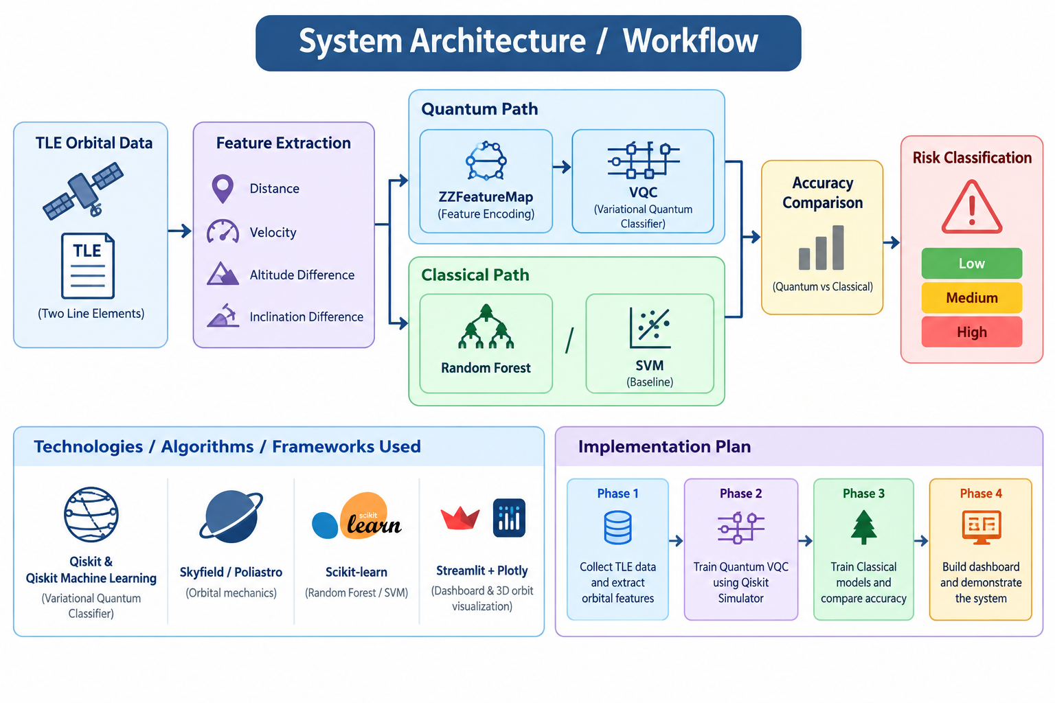

4. Technical Design

Slide 5
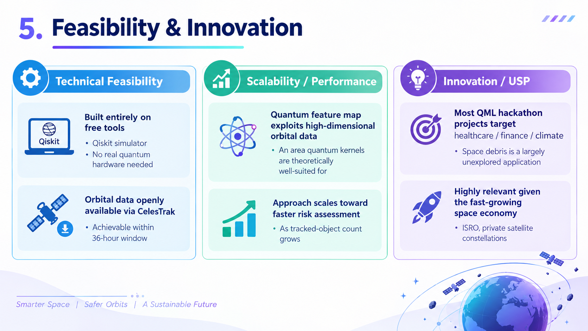
5. Feasibility & Innovation

Slide 6
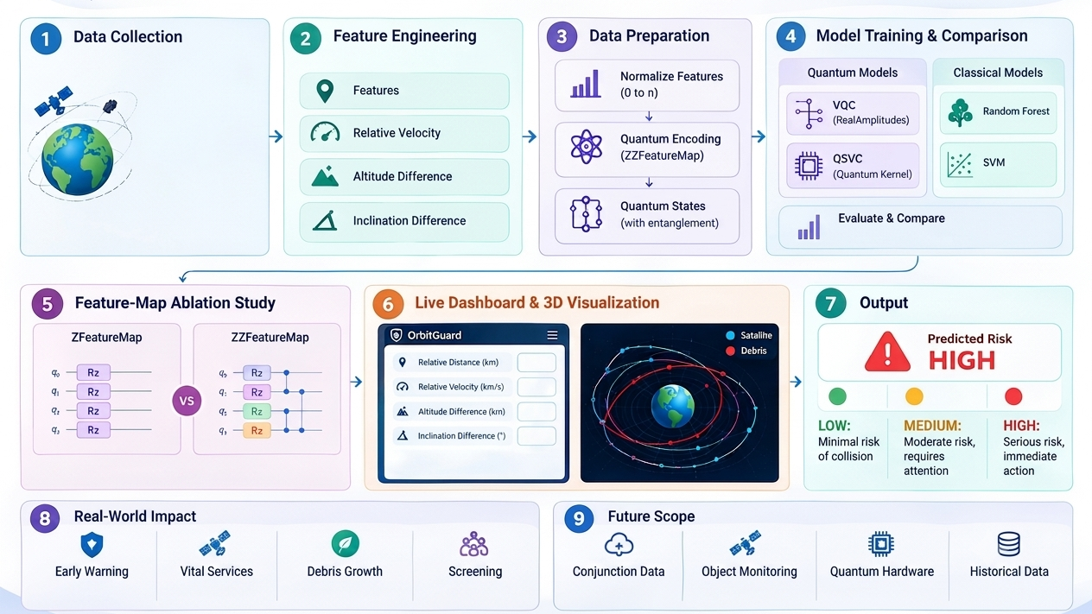
6. Expected Outcome
Data from Public Source
(TLE)

